Slide 1


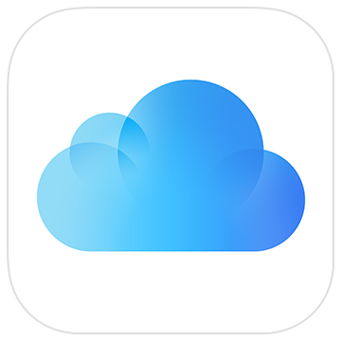
Pocket Water Tracker
Simple and Easy-to-Use
Water Tracker and Reminder
And it is Open-Source!
Privacy too
🔒
Log & Save with
ONLY with

Slide 2
口袋喝水助手
简单好用的
喝水追踪和提醒助手
同时还开源!
隐私也上
🔒
所有数据保存在
且仅保存在

Slide 3
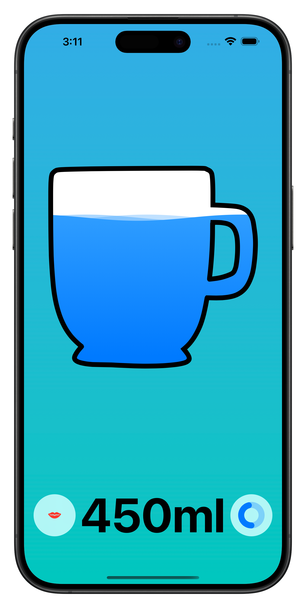
Log Your Water Drinking
with A Tap of Finger

Slide 4
弹指间
记录你每天的喝水数据

Slide 5
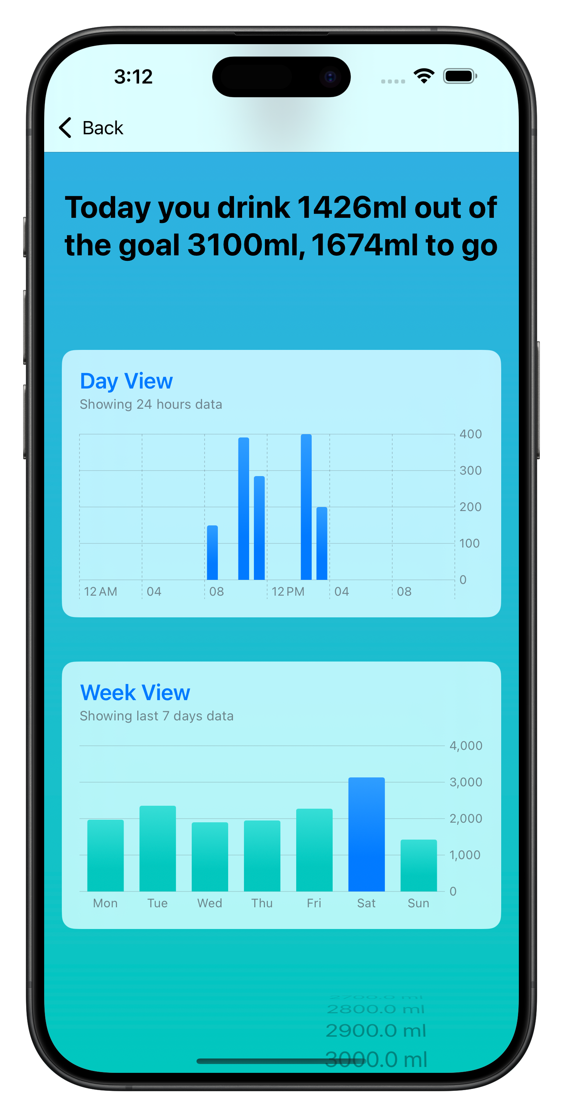
Show Daily
Water Summary

Slide 6
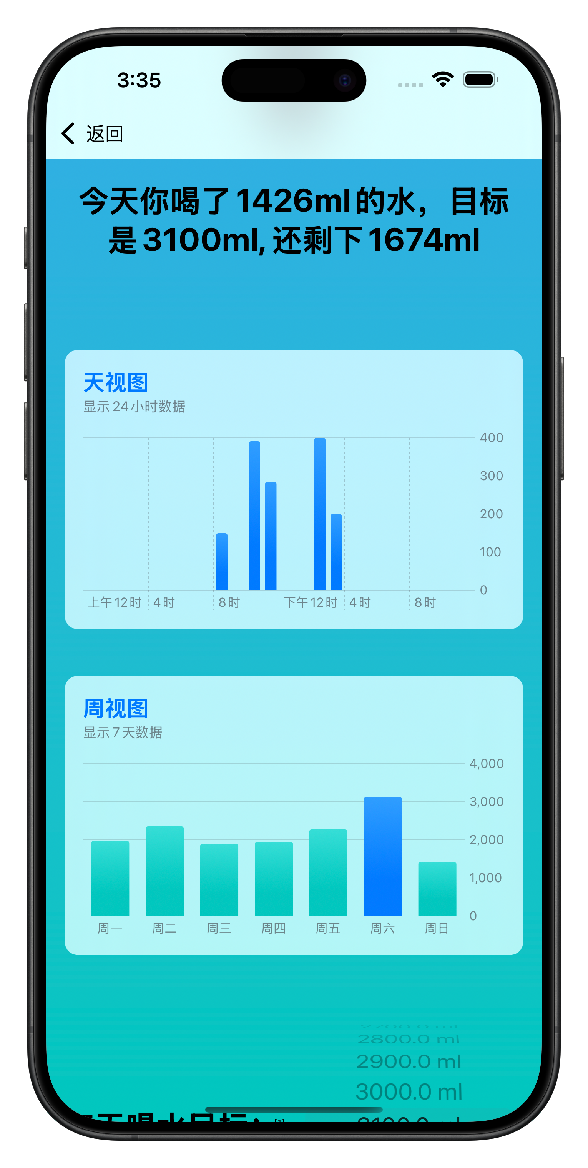
快速查看你的喝水记录

Slide 7
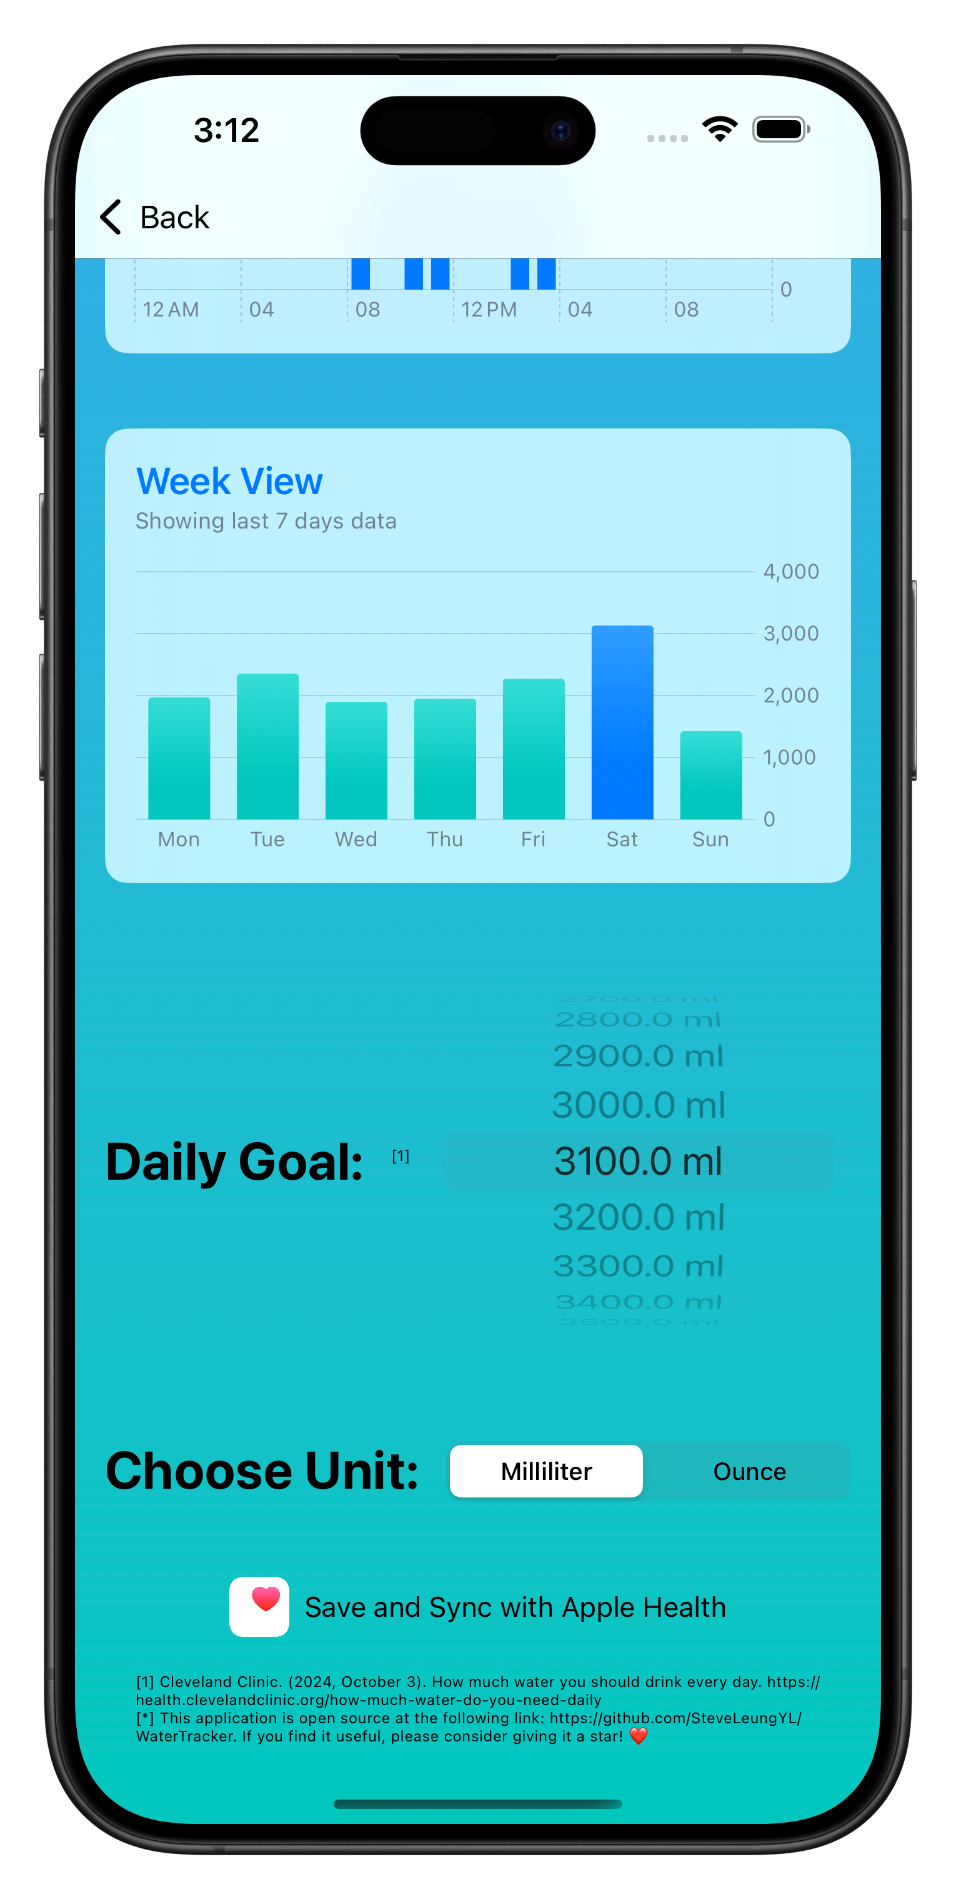
Flexible Daily Goal
& Unit

Slide 8
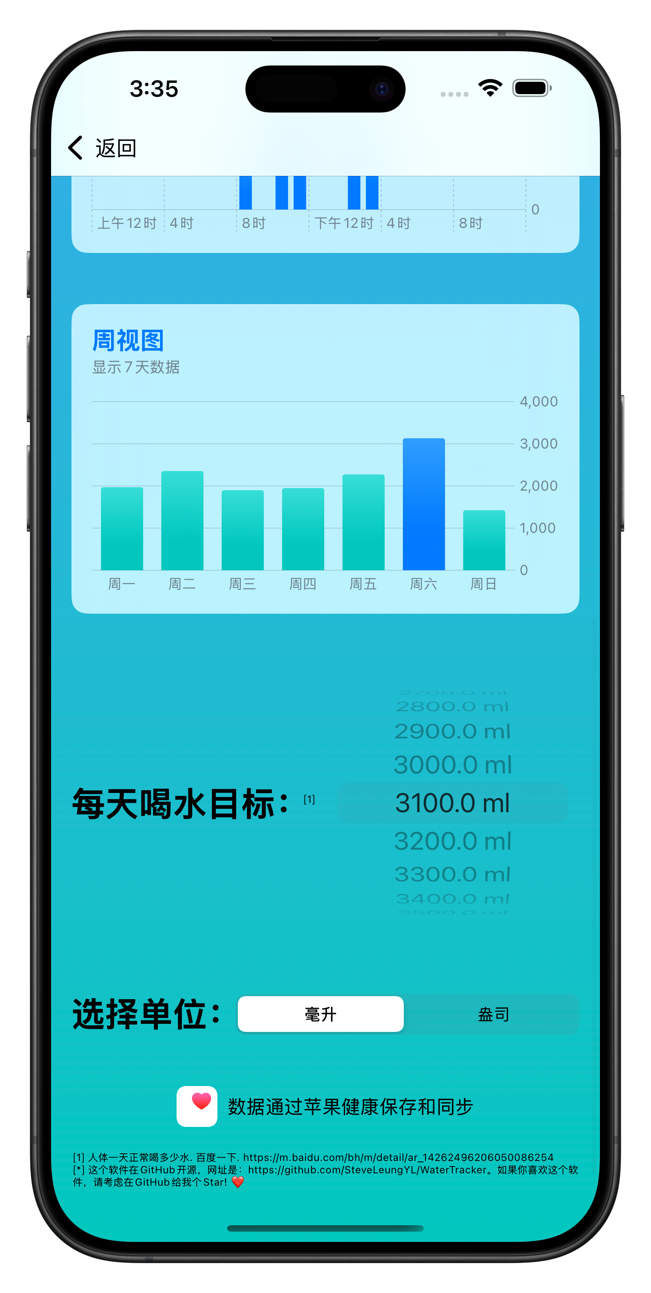
灵活的单位换算
和每日计划制定

Slide 9
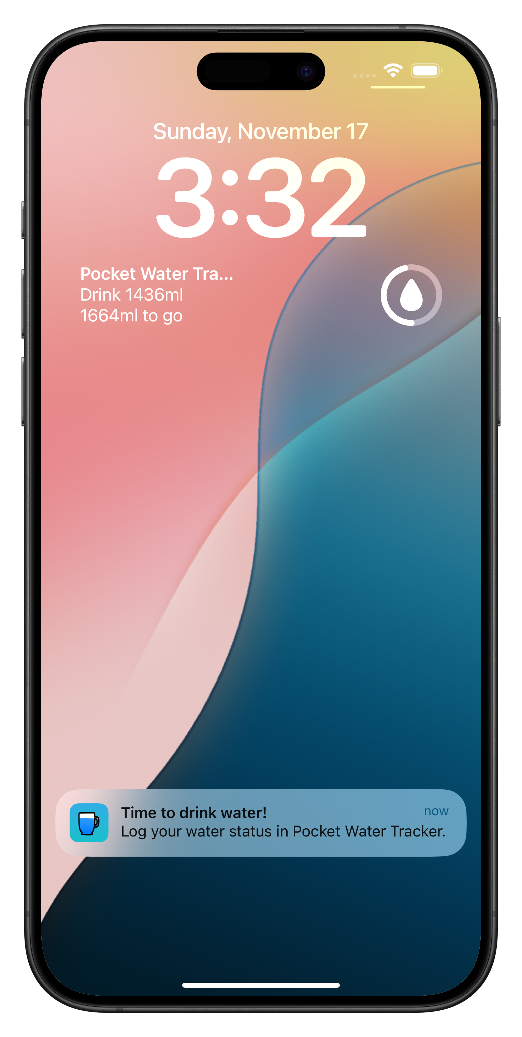
Water Reminder After
2 Hours of Each Drink Logging

Slide 10
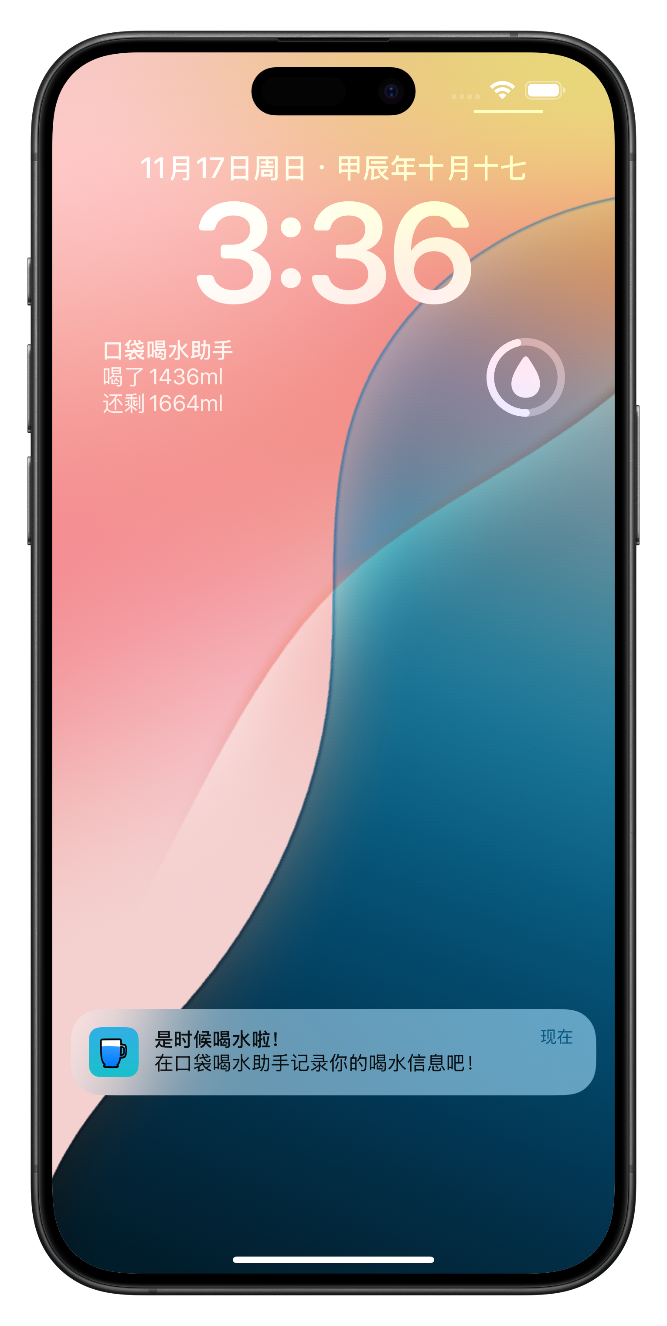
智能2小时喝水提醒

Slide 11
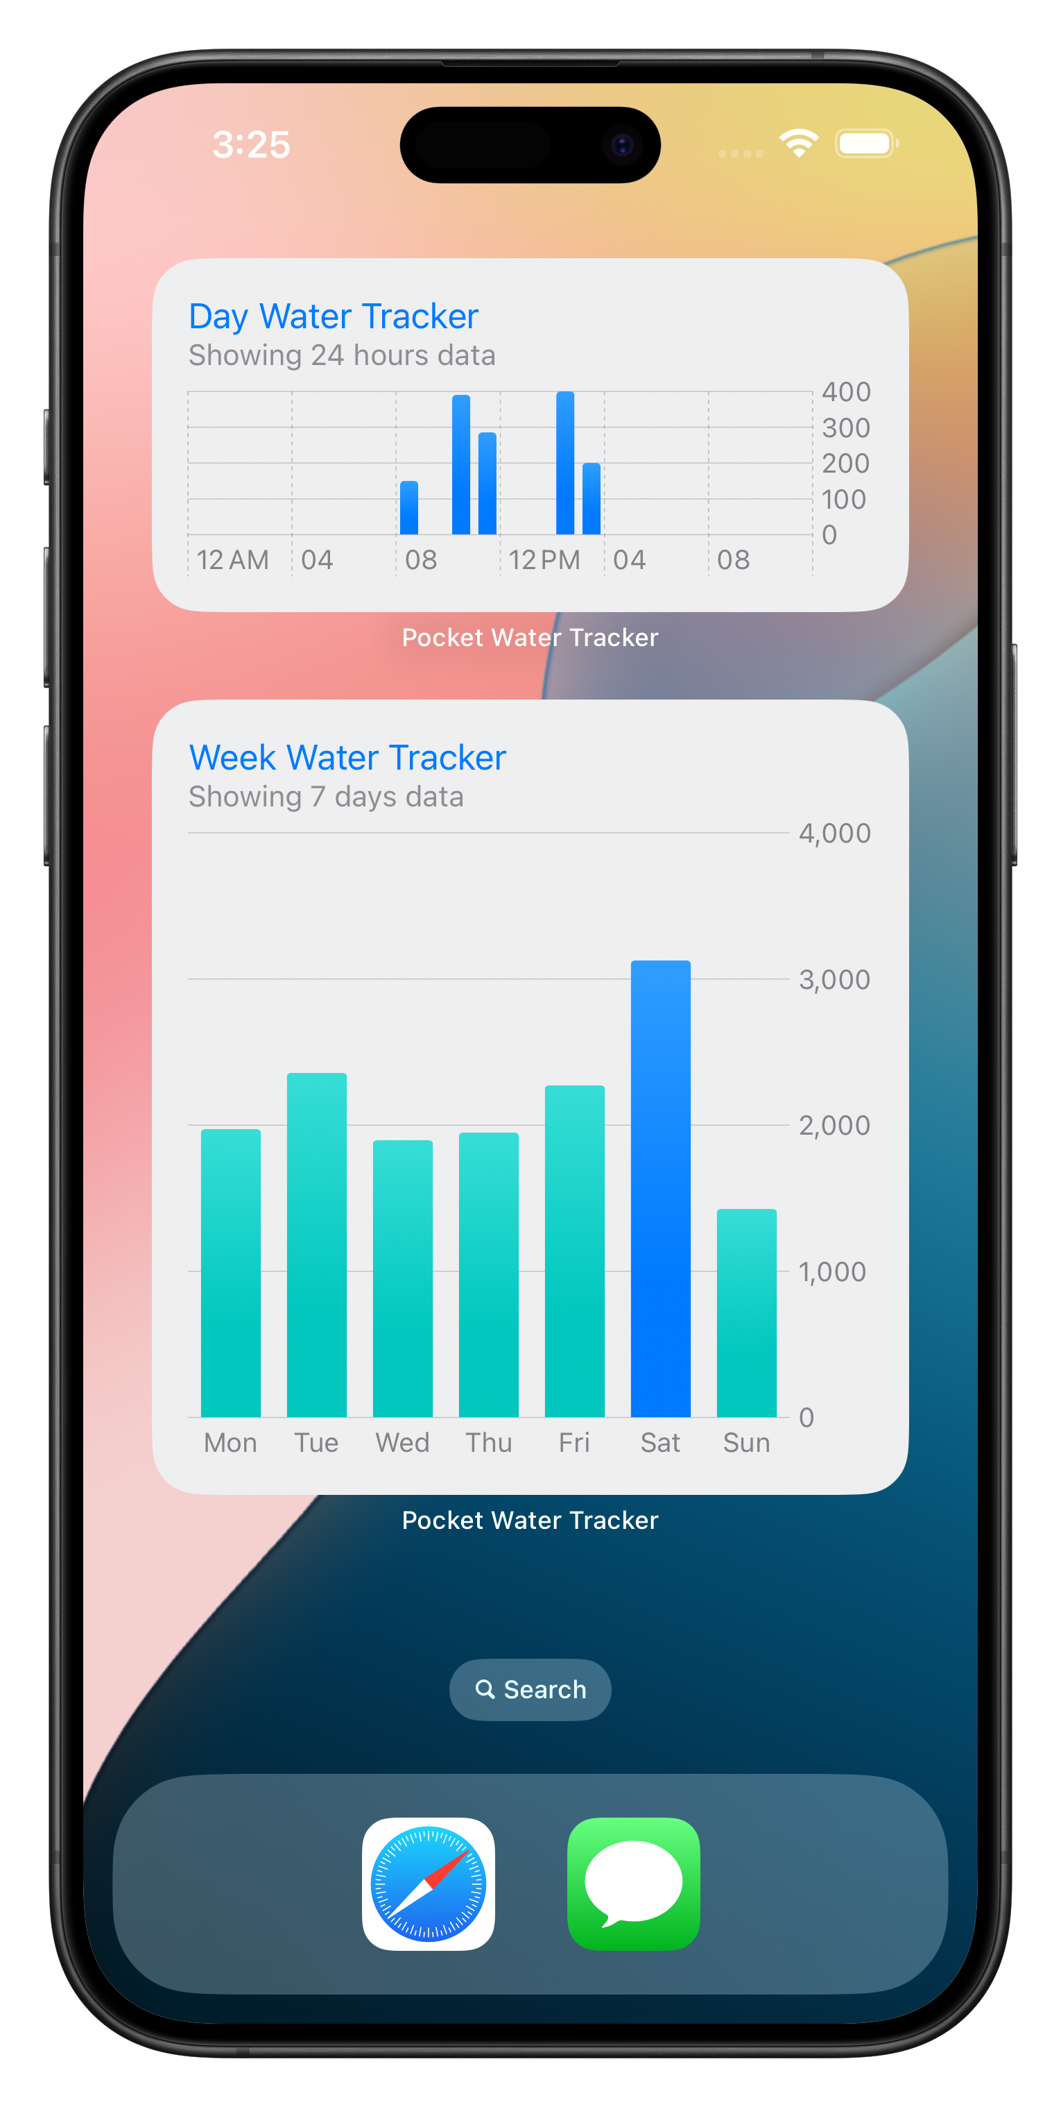
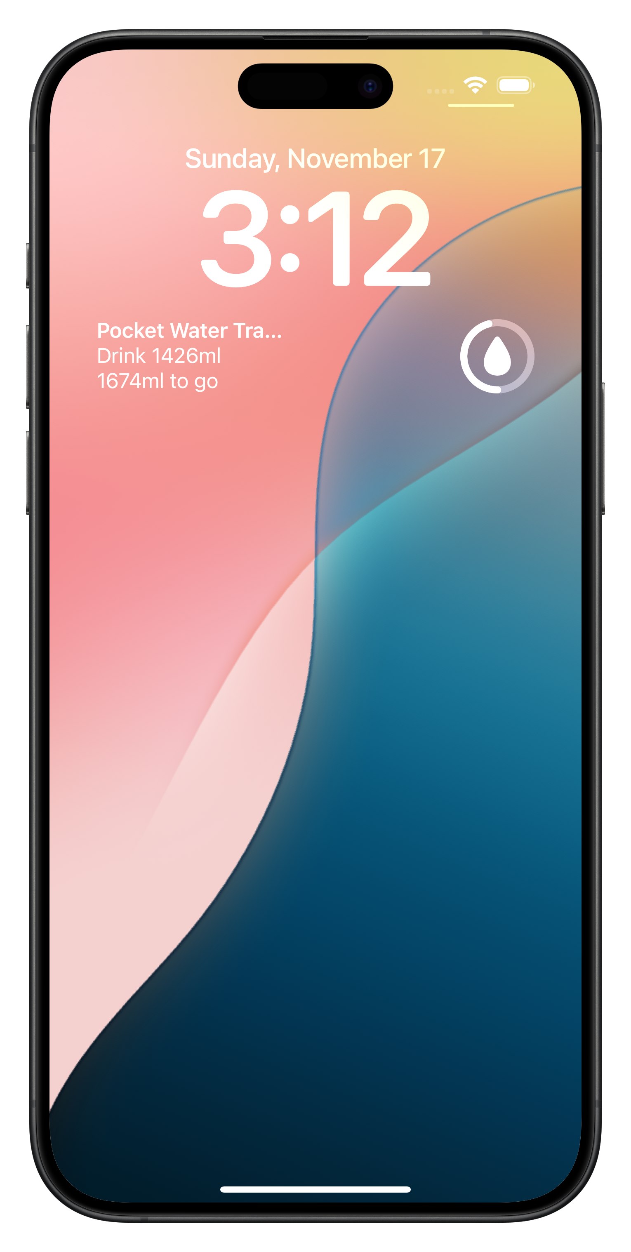
Widgets on
Your Home Screen

Slide 12


还有桌面小组件

Slide 13
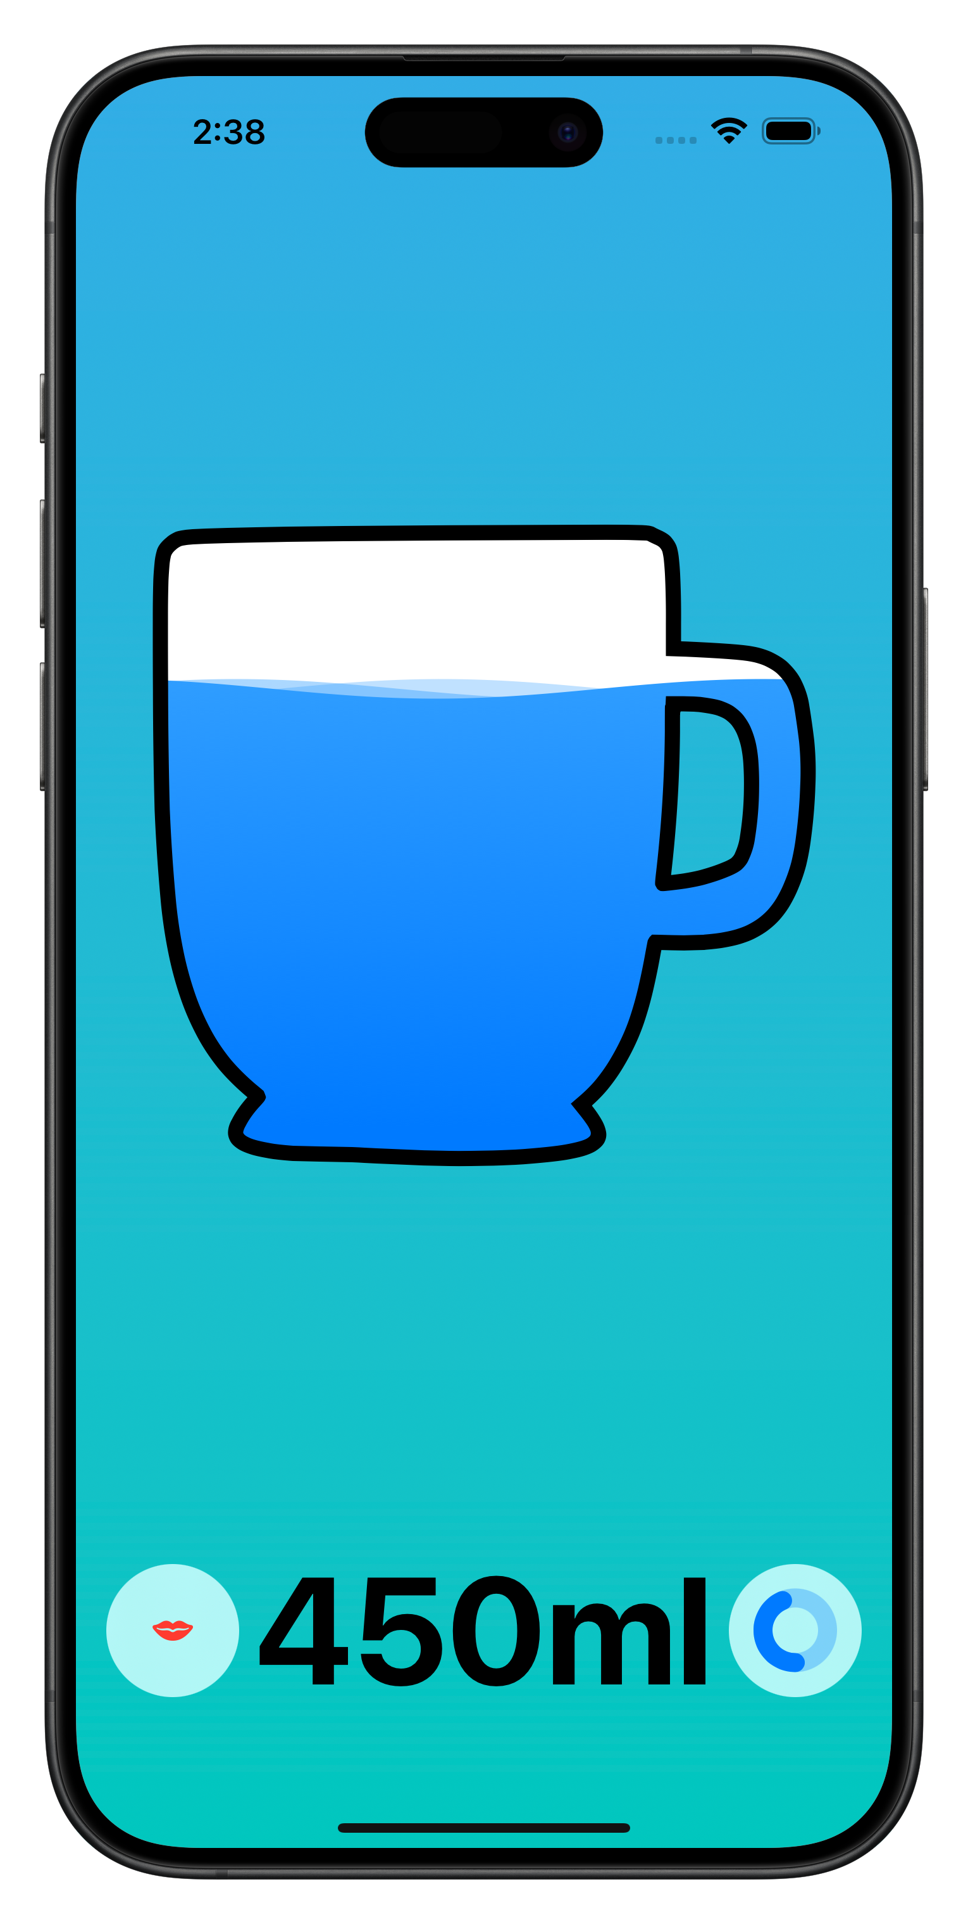
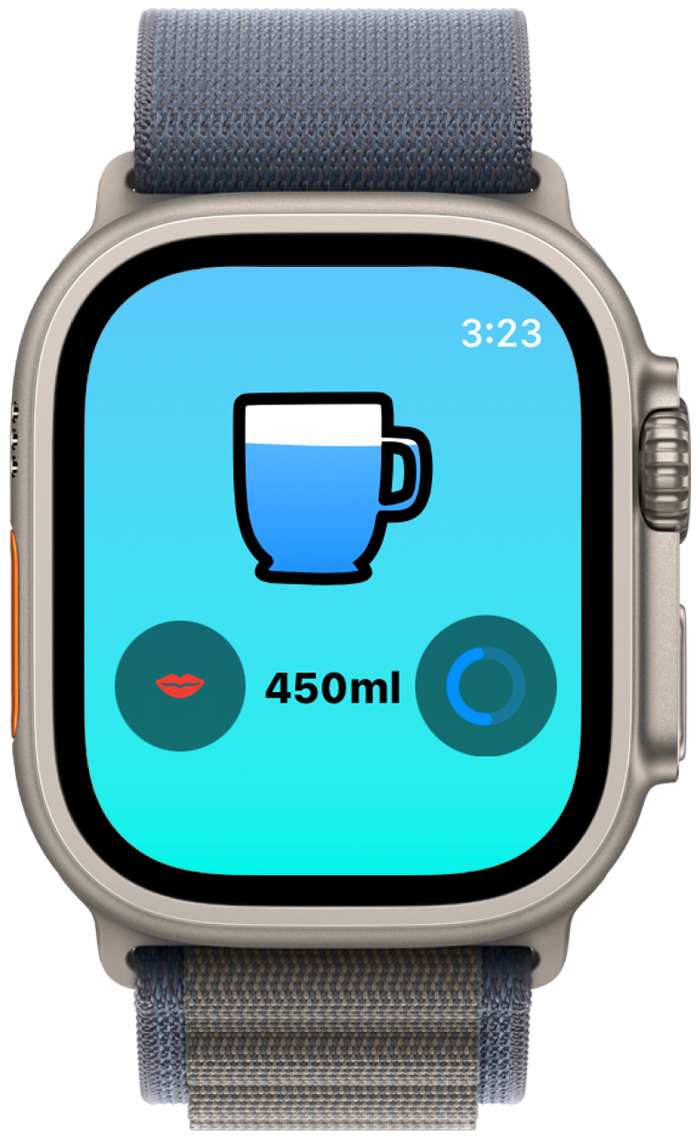
Works Best with
Your Apple Watch

Slide 14
与Apple Watch配合
更好用

